Slide 1
Uncommon Grounds
Trevor Kearns, Patrick Barber, Emily Emmons, Liam McCarthy, Anthony Lee, Dmitry Aristarkhov

Slide 2
Description
Uncommon Grounds is a social media application that allows users to connect with and explore special locations off the beaten track. Unlike similar applications, Uncommon Grounds focuses on non-commercial locations that are not widely known, encouraging users to stretch their legs and get to appreciate the unique character of their physical environment. Users can also connect with fellow explorers who share their tastes in peculiar, magical, peaceful, or secret places.

Slide 3
Targeted Users
Anybody who likes to explore
Particularly those who are between ages 18 - 65
This is because we expect people who like to explore tend to be within those ranges and can do so with relative ease
It’s also ideally what the site age range would be

Slide 4
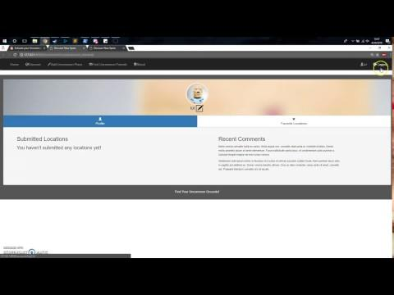

Slide 5


Slide 6


Slide 7
What was Easy
What was Hard
Coming up with the models
Coming up with the design of the bootstrap
Coming up with the website idea
HTML mockups
Teamwork aspects
Fixing Autocomplete
Bug fixing
Setting up profile pages
Implementing email verification
Autocomplete
Adding images dynamically and accessing them
Working with forms
Working with Django
Git Conflicts
Figuring out how Git worked
Bug fixing

Slide 8
Future Work
Implement Google maps with the locations
Auto moderation bots
Would peruse comments and places
Deletes comments and places that contain rude or otherwise inflammatory or suspicious language
Sends reports of possible fake users to the admin
Popular ‘unpopular’ areas
Meetups/Events
Reviews from users of locations
Mobile apps

Slide 9
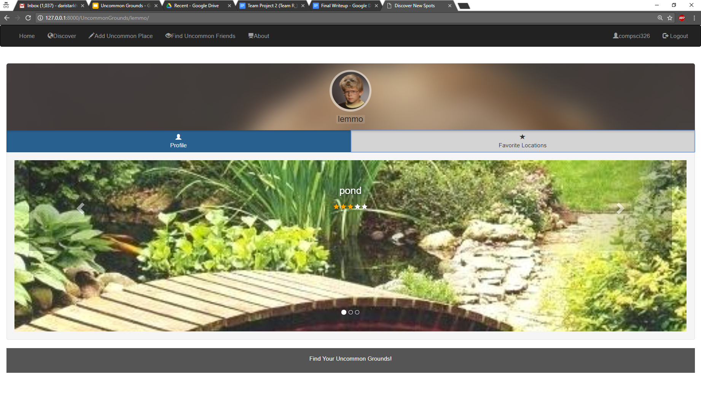
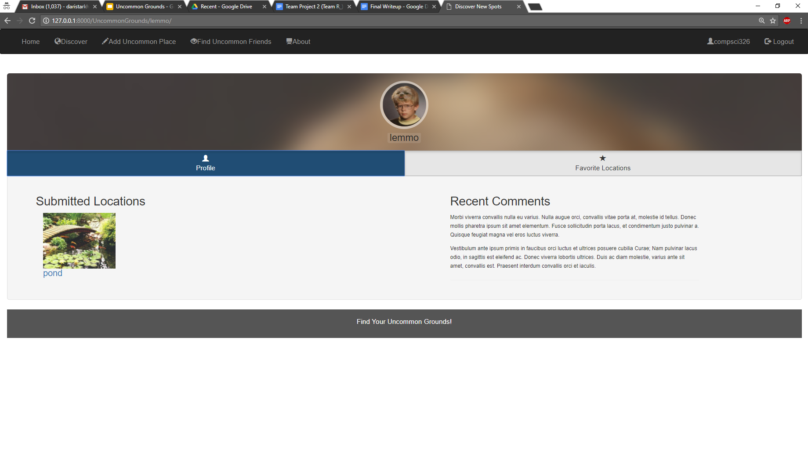
Team R_: Uncommon Grounds

